Slide 1
Mobile prices data analysis
Name : K.Ranjith Kumar Reddy
REGISTRATION NO :12111200
Roll no :RK21UNA08

Slide 2
Table of content
INTRODUCTION
LIBRARIES USED
SAMPLE DATA
STATICS
INSIGHTS
CONCLUSION

Slide 3
Introduction
The Mobile Prices Dataset is a collection of data related to mobile phones and their pricing. This dataset provides valuable information for analysis, research, and decision-making in the mobile industry. It can be used by researchers, analysts, and businesses to gain insights into the mobile phone market, consumer preferences, and pricing strategies. The dataset was compiled from various sources, including online marketplaces, retailers, and manufacturers. It represents a diverse range of mobile phones available in the market.

Slide 4
LIBRARIES USED
PANDAS :
Pandas is a Python library for data manipulation and analysis. It provides data structures like Data Frame and Series to work with structured data easily. Pandas is commonly used for tasks such as cleaning, transforming, and analyzing datasets, making it an essential tool in data science and analysis workflows.
NUMPY :
NumPy is a powerful Python library for numerical computing. It provides support for large, multi-dimensional arrays and matrices, along with mathematical functions to operate on these arrays efficiently. NumPy is widely used in scientific and mathematical applications and serves as a fundamental building block for many other libraries in the Python ecosystem, especially in the fields of data science and machine learning.

Slide 5
MATPLOTLYB :
Matplotlib is a versatile Python library for creating static, animated, and interactive visualizations. It provides a wide range of plotting functions to generate high-quality charts, graphs, and plots. Matplotlib is often used in data analysis, scientific computing, and machine learning to visualize data and results in a clear and effective manner.
SEABORN :
Seaborn is a Python data visualization library built on top of Matplotlib. It provides a high-level interface for creating attractive and informative statistical graphics. Seaborn simplifies the process of generating complex visualizations with concise syntax and default themes, making it particularly useful for exploring and presenting data in a visually appealing way.

Slide 6
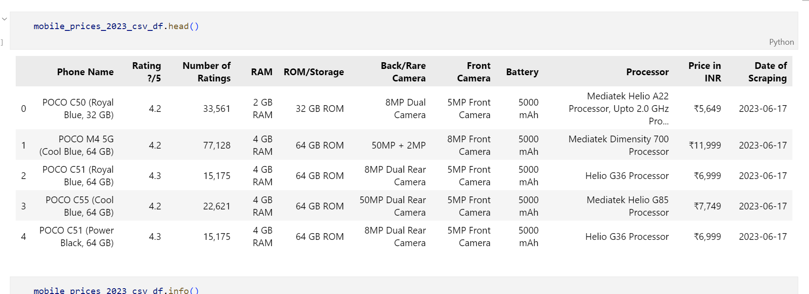
Sample data

Slide 7
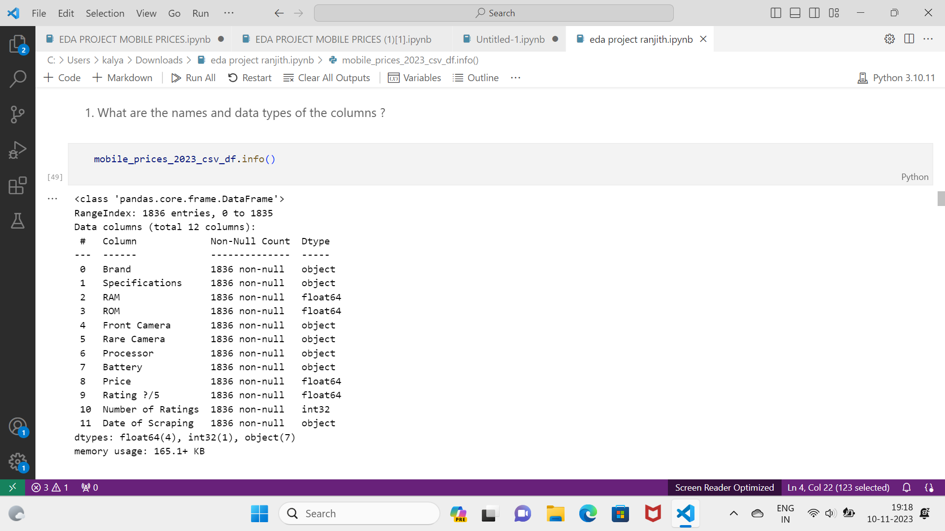

Slide 8
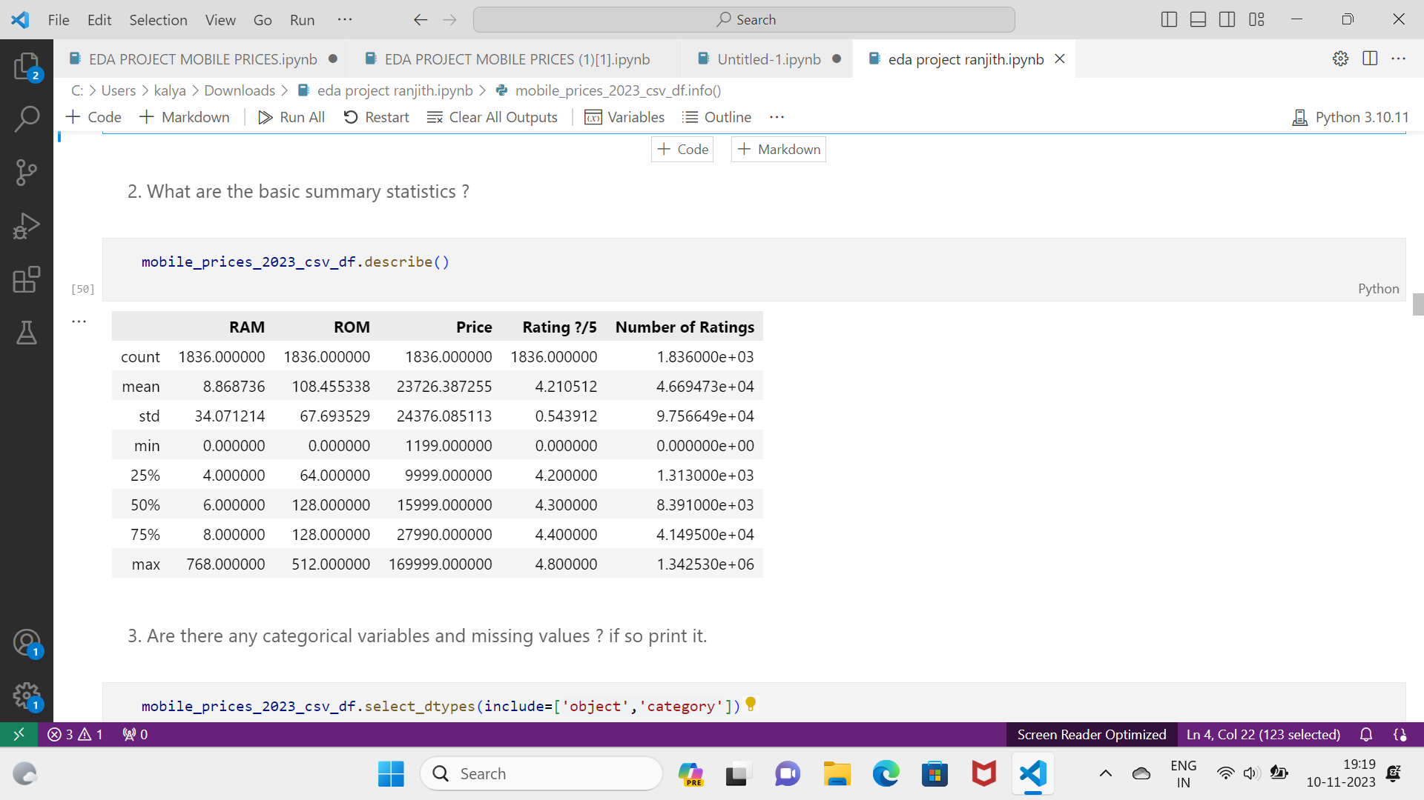

Slide 9
3) Are there any categorical variables and missing values? If so print it.

Slide 10
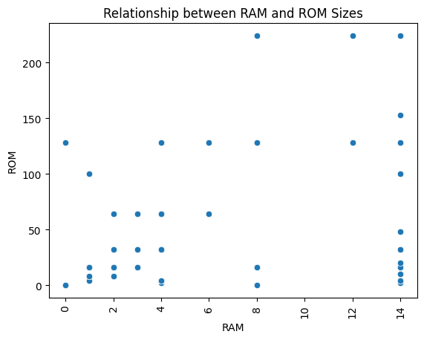
4) Is there a relationship between RAM and ROM sizes?

Slide 11
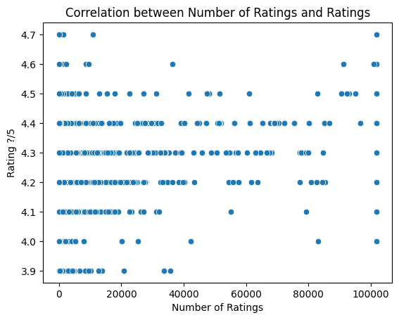
5)Is there a correlation between the number of ratings and ratings?

Slide 12
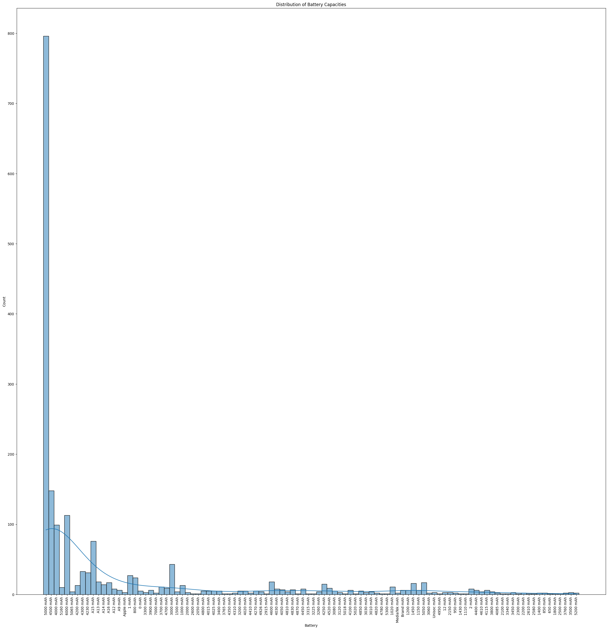
6)What is the distribution of battery capacities among the phones in the dataset, and how common are different capacity levels?

Slide 13
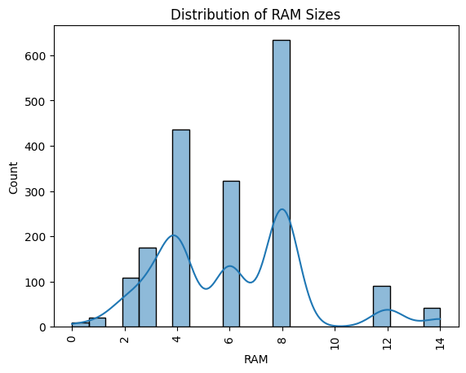
7) Which is most commonly used Ram in phone?

Slide 14
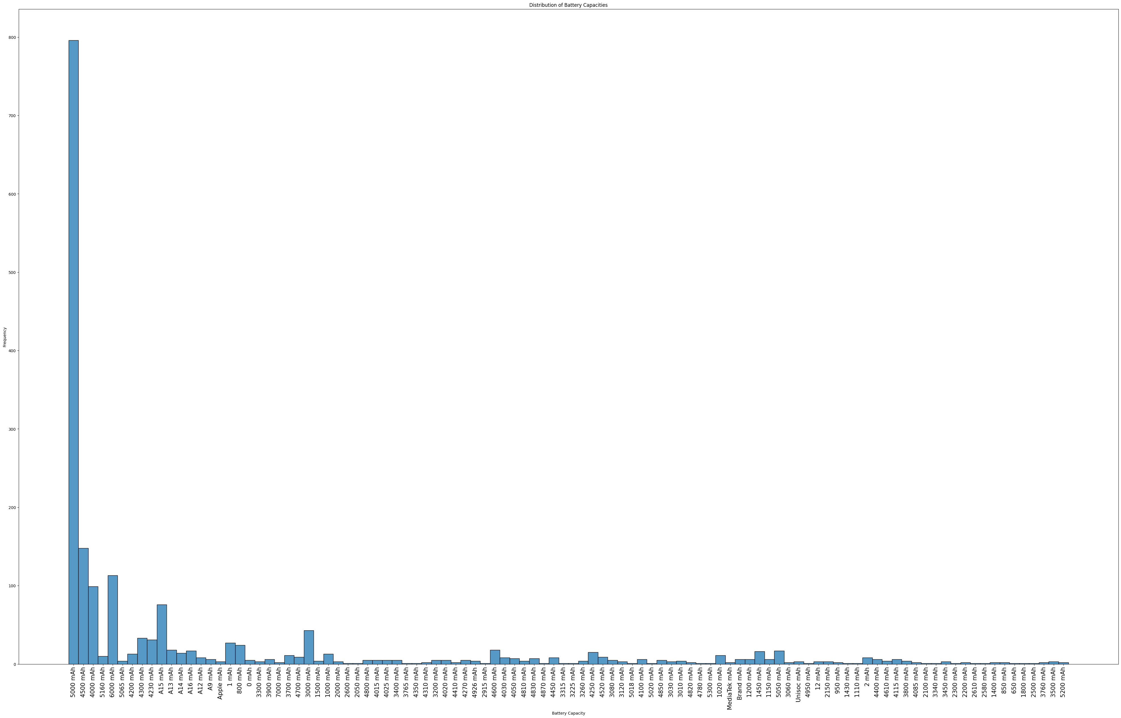
8) Which is most commonly used back/rear camera in phones?

Slide 15
INSIGHTS
Average Rating:
- The average rating of phones in the dataset is 4.27.
2. Most Common Phone Names:
- The most common phone names and their counts are listed, with "APPLE iPhone 14" having the highest count (16).
Negative Correlation:
- There is a negative correlation between RAM and battery power capacity. As RAM increases, battery power capacity decreases.
4. Weak Positive Correlation:
- There is a weak positive correlation, but the variables involved are not specified.
5. High Positive Correlation:
- There is a high positive correlation, with a correlation coefficient nearing 1. When the value in one variable increases, the value in another variable also increases.

Slide 16
6. Rating Distribution:
- Most people rated their phones in the 4 to 5 range.
7. Weak Positive Correlation (Another Instance):
- There is a weak positive correlation between unspecified variables.
8. Positive Correlation: Higher Battery, Higher Price:
- There is a positive correlation between higher battery capacity and a higher price.
9. Positive Correlation: Higher ROM, Higher Price:
- There is a positive correlation between higher ROM (storage) and a higher price.
10. Most Common Back/Rear Camera:
- The most commonly used back/rear camera in phones is 50 MP.

Slide 17
16. Camera Resolution:
- The highest used back camera resolution is 50 MP, and the lowest is 12 MP + 20 MP.
- The highest used front camera resolution is 16 MP, and the lowest is 8 MP + 8 MP.
17. Battery Capacity Range:
- The highest battery capacity is 5000 mAh, and the lowest is 1500 mAh.
18. Price Range:
- The highest price of phones is Rupees 1,69,999, with specific models listed.
- The least expensive phones are priced at Rupees 1,199, including Nokia 105 and Nokia Ta – 1010/105.
19. Dataset Information:
- The dataset has 1836 entries with various features, including brand, specifications, RAM, ROM, camera details, processor, battery, price, rating, and the number of ratings.

Slide 18
11. Most Common Front Camera:
- The most commonly used front camera in phones is 16 MP.
12. Most Common ROM:
- The most commonly used ROM in phones is 128 GB.
13. Most Common Battery Capacity:
- The most commonly used battery capacity in phones is 5000 mAh.
14. Most Common Processor:
- The most commonly used processor in phones is Qualcomm Snapdragon 680 Processor.
15. Most Common RAM:
- The most commonly used RAM in phones is 8 GB.

Slide 19
CONCLUSION :
In conclusion, the Mobile Prices dataset provides valuable insights into the mobile phone market, consumer preferences, and pricing strategies. The dataset can be used by researchers, analysts, and businesses to gain insights into the mobile phone industry. The analysis of the dataset reveals interesting correlations between various features of mobile phones and their prices. The dataset can be further explored to gain more insights and make informed decisions in the mobile phone industry.

